Slide 1
COS 212 B*-Trees

Slide 2
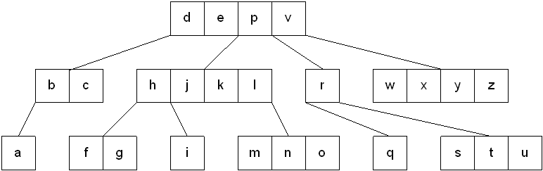
B-trees: Recap
What is an m-way search tree?
Each node has m children and m-1 key fields
The keys in each node are in ascending order
The keys in the first i children are smaller than the i-th key
The keys in the last m-i children are larger than the i-th key

Slide 3
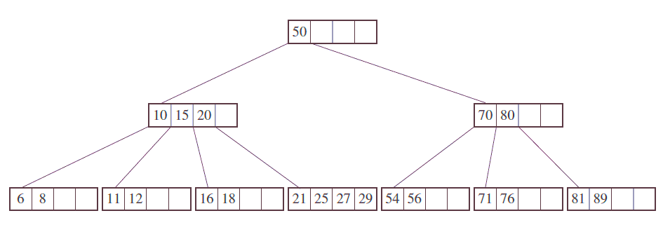
B-trees: Recap
What is a B-tree?
The root has at least two subtrees unless it is the only node in the tree
Each non-root node is at least half-full of keys
The number of keys in each non-root node that is also a non-leaf node must be one less than the number of its non-empty children
All leaves are on the same level
This implies that B-trees cannot grow at the leaves
They must grow at the root

Slide 4
B-trees
The restrictions in the previous slide make B-trees always at least half full, have few levels, and remain perfectly balanced
But is this good enough?
What makes B-trees efficient?
Assuming the B-tree is represented on secondary storage
We can fetch the entire memory block, not just one data item
But, if the B-tree is half-full, half of the space is wasted
What if we make the rule more strict?
Ensure every node is at least two-thirds full

Slide 5
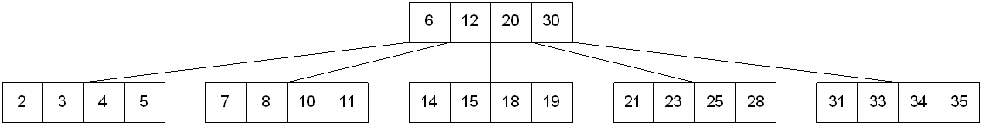
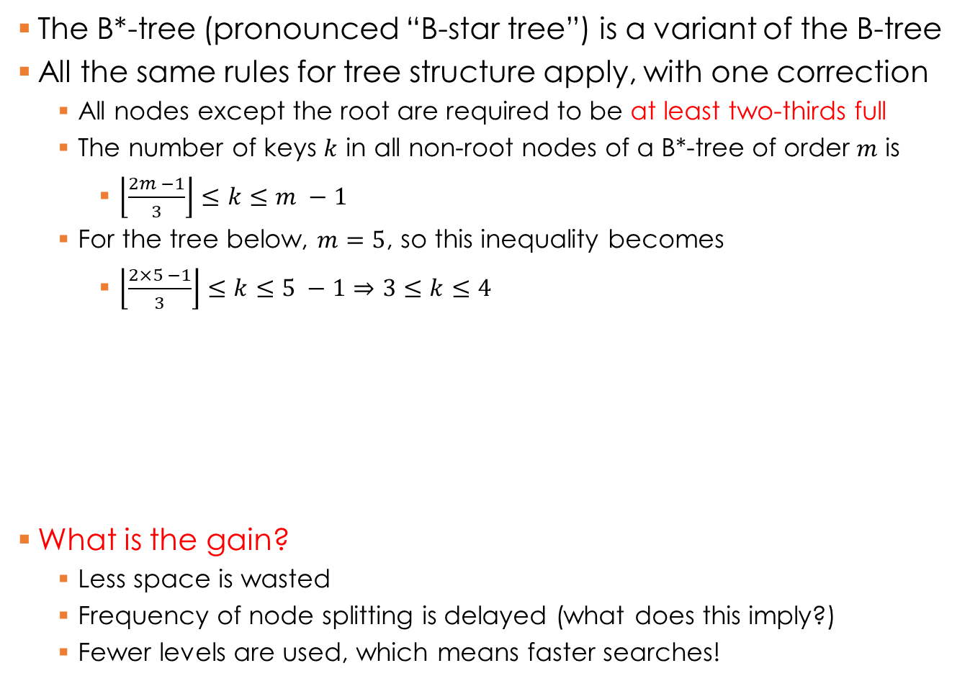
B*-trees
The B*-tree (pronounced “B-star tree”) is a variant of the B-tree
All the same rules for tree structure apply, with one correction
All nodes except the root are required to be at least two-thirds full
The number of keys $k$ in all non-root nodes of a B*-tree of order $m$ is
$\left\lfloor \frac{2m −1}{3}\right\rfloor ≤k≤m −1$
For the tree below, $m=5$, so this inequality becomes
$\left\lfloor \frac{2×5 −1}{3}\right\rfloor ≤k≤5 −1⇒3≤k≤4$
What is the gain?
Less space is wasted
Frequency of node splitting is delayed (what does this imply?)
Fewer levels are used, which means faster searches!

Slide 6
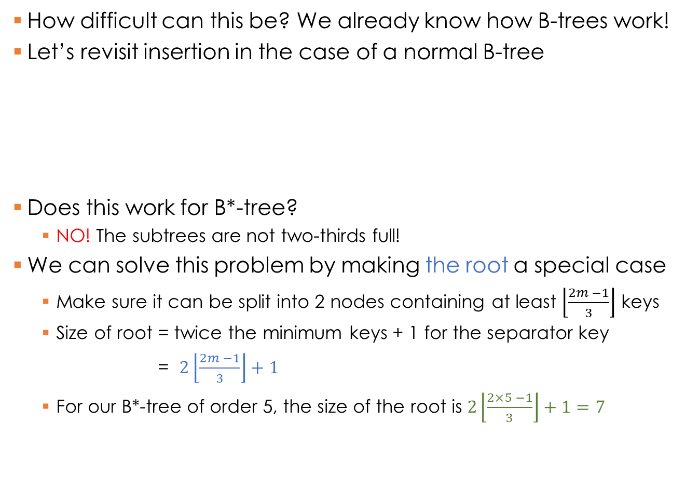
B*-trees: Insert
How difficult can this be? We already know how B-trees work!
Let’s revisit insertion in the case of a normal B-tree
Does this work for B*-tree?
NO! The subtrees are not two-thirds full!
We can solve this problem by making the root a special case
Make sure it can be split into 2 nodes containing at least $\left\lfloor \frac{2m −1}{3}\right\rfloor$ keys
Size of root = twice the minimum keys + 1 for the separator key Size of root = $2\left\lfloor \frac{2m −1}{3}\right\rfloor +1$
For our B*-tree of order 5, the size of the root is $2\left\lfloor \frac{2×5 −1}{3}\right\rfloor +1=7$
15
12
29
41
57

Slide 7
B*-trees: Insert
If we have a sufficiently large root
Inserting into a leaf with space works the same as in a B-tree
Inserting into a full root works the same as in a B-tree
For example
For our order 5 tree we need a root of size 7
Let’s perform an insertion into a full root
But, inserting into a full leaf node works a little differently
In a B-tree
Split the leaf into two nodes and redistributed the keys
In a B*-tree
Depends on whether at least one sibling has space
17
3
7
12
15
29
41
57

Slide 8
B*-trees: Insert
Inserting a value into a leaf
Find the leaf into which the new value will be inserted
If there is space in the leaf, just insert the item (same as for B-tree)
If the leaf is full, check if either sibling of the leaf has space
If space is available in at least one sibling
Redistribute data between the leaf, the leaf’s sibling, and their parent
If space is not available in either sibling
Create a new node
Redistribute data between the leaf, one of the leaf’s siblings, the newly created node, and their parent
Let’s look at each of these cases separately

Slide 9
B*-trees: Insert
Inserting a value into a leaf
Find the leaf into which the new value will be inserted
If there is space in the leaf, just insert the item (same as for B-tree)
If the leaf is full, check if either sibling of the leaf has space
If space is available in at least one sibling
Build a list containing keys from the leaf being inserted into, the sibling, and the parent key of the leaf being inserted into
Move the middle key in the list to replace the parent key
Move keys left of the middle key into the leftmost of the 2 leaf nodes
Move keys right of the middle key into the rightmost of the 2 leaf nodes
16
17
3
7
12
15
29
41
57
3 7 12 15 16 17 29 41 57
The insertion takes place within the leaf node on the leftmost branch of the root
Construct a list that contains all the keys that need to be redistributed
The leftmost leaf is full and the right sibling has space, so redistribute data in the leftmost leaf, its right sibling, and the parent
Middle key in the list replaces parent key, while left keys go to the leftmost leaf and right keys go to the right sibling

Slide 10


B*-trees: Insert
Inserting a value into a leaf
If the leaf is full, check if either sibling of the leaf has space
If space is not available in either sibling
Create a new node right of the leaf being inserted into and its sibling
Build a list containing keys from the leaf being inserted into, the sibling, and the parent key of the leaf being inserted into
Find two reference point values in the list that divide the list into three
Insert the reference point keys into the parent – this may require shifting parent keys to the right to make space
Move remaining keys in the list into the three leaf nodes from left to right
35
16
Underflow!
3 7 12 15 16 17 29 35 41 57
3
7
15
17
29
41
57
$$i=\left\lfloor \frac{2m −1}{3}\right\rfloor =3$$
$$j=2i+1=7$$
12
The insertion takes place within the leaf node on the rightmost branch of the root
Construct a list that contains all the keys that need to be redistributed
Rightmost leaf and left sibling are full, so make a new node and redistribute keys in rightmost leaf, its left sibling, and the parent
Find 2 reference points dividing list into 3 and move them to parent, then redistribute remaining values between children

Slide 11
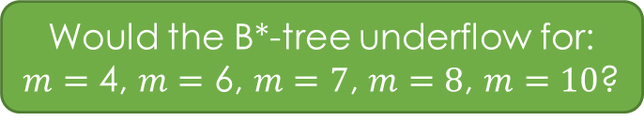

B*-trees: Insert
There are too few keys to prevent the underflow
But why did this happen?
We took two full leaf nodes with $\text{2}\left(\text{max}\right)$ total keys, where $\text{max}=m−\text{1}$
To have sufficient keys in all nodes we need to split these keys between 3 nodes such that each node has $\text{min}=\left\lfloor \frac{2m −1}{3}\right\rfloor$ keys
In order to be able to do this, $\text{2}\left(\text{max}\right)$ must be $≥\text{3}\left(\text{min}\right)$
Is this the case for $m=\text{5}$?
$\text{2}\left(\text{max}\right)=\text{2}\left(m−1\right)=\text{2}×\text{4}=\text{8}$
$\text{3}\left(\text{min}\right)=\text{3}\left\lfloor \frac{2m −1}{3}\right\rfloor =\text{3}×\text{3}=\text{9}$
$\text{8}<\text{9}$
So $m=\text{5}$ is the cause of the underflow
15
35
Underflow!
3
7
12
16
17
29
41
57
Would the B*-tree underflow for: $m=\text{4}$, $m=\text{6}$, $m=\text{7}$, $m=\text{8}$, $m=\text{10}$?

Slide 12



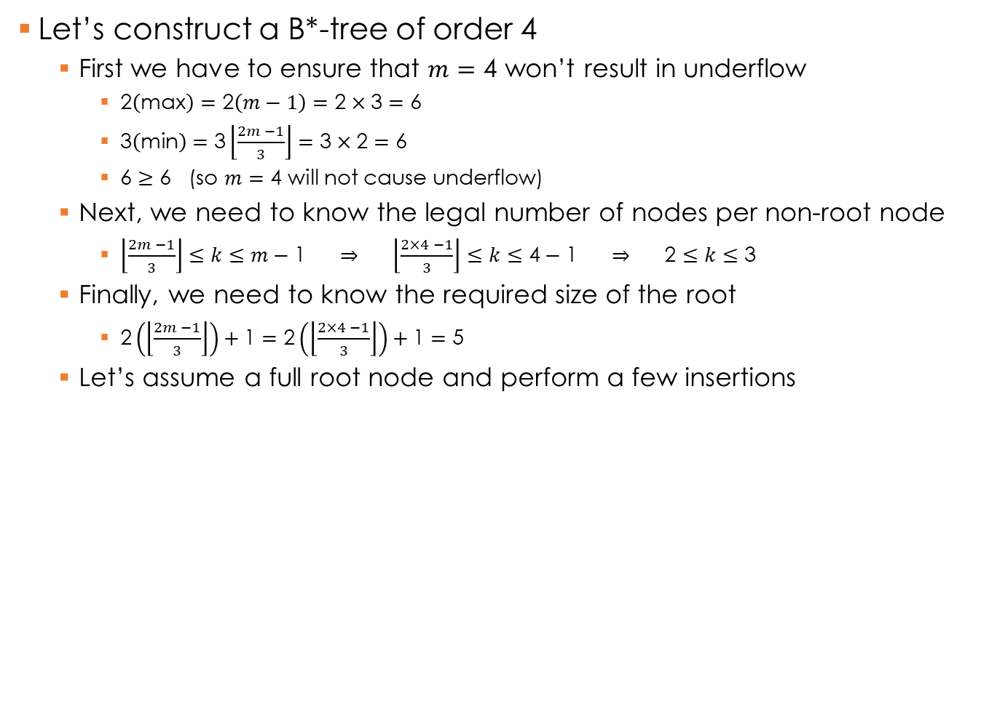
B*-trees: Insert
Let’s construct a B*-tree of order 4
First we have to ensure that $m=\text{4}$ won’t result in underflow
$\text{2}\left(\text{max}\right)=\text{2}\left(m−1\right)=\text{2}×\text{3}=\text{6}$
$\text{3}\left(\text{min}\right)=\text{3}\left\lfloor \frac{2m −1}{3}\right\rfloor =\text{3}×\text{2}=\text{6}$
$\text{6}≥\text{6}$ (so $m=\text{4}$ will not cause underflow)
Next, we need to know the legal number of nodes per non-root node
$\left\lfloor \frac{2m −1}{3}\right\rfloor ≤k≤m−\text{1} ⇒ \left\lfloor \frac{2×4 −1}{3}\right\rfloor ≤k≤\text{4}−\text{1} ⇒ \text{2}≤k≤\text{3}$
Finally, we need to know the required size of the root
$\text{2}\left(\left\lfloor \frac{2m −1}{3}\right\rfloor \right)+\text{1}=\text{2}\left(\left\lfloor \frac{2×4 −1}{3}\right\rfloor \right)+\text{1}=\text{5}$
Let’s assume a full root node and perform a few insertions
$$i=\left\lceil m+1/2\right\rceil =3$$
3 7 12 15 17 29
30
13
3
7
12
15
29
17
3 7 12 13 15 17 29 30
$$i=\left\lfloor \frac{2m −1}{3}\right\rfloor =2$$
$$j=2i+1=5$$

Slide 13
B*-trees: Delete
Similar to B-Tree delete
If deleting a non-leaf key, perform delete by copying
Same as for B-tree
Replace key to be deleted by its immediate predecessor
This may cause underflows that need to be dealt with
If deleting from a leaf
If there are sufficient keys after the delete
Same as for B-tree
Delete key and fill the gap
If there are insufficient keys after the delete, things are a little different
If there is a sibling with keys exceeding the minimum requirement
Same as for B-tree
Redistribute keys between the leaf, the sibling, and the root
If there is no sibling with keys exceeding the minimum requirement
Different from B-tree
In a B-tree, merge leaf, parent, and 1 sibling into leaf, then delete sibling
In a B*-tree, merge leaf, parent, and both siblings, then delete 1 sibling

Slide 14
B*-trees: Delete
Let’s look at an example
Delete 17 (a non-leaf key)
Does either sibling have more than the minimum number of keys?
No! So merge the three nodes into two
12
17
3
7
15
13
29
30
Underflow!
12
15
3 7 12 13 15 29 30
3
7
13
29
30

Slide 15
B*-trees: Delete
Delete 13 (a non-leaf key)
Delete 7 (a leaf node)
Does a sibling have more than the minimum number of keys?
Yes! So redistribute the keys between the node and its sibling
13
3
7
12
15
29
30
Underflow!
12
3
7
15
29
30
What would happen if we deleted 30?
12
3 12 15 29 30
3
15
29
30

